Slide 1




分布式系统
Distributed Systems
陈鹏飞 吴维刚
{chchenpf7, wuweig}@mail.sysu.edu.cn
主页：http://cse.sysu.edu.cn/

Slide 2
Paxos
L. Lamport, The Part-time Parliament, ACM Transactions on Computer Systems, 1998.
希腊岛屿Paxon上的执法者在议会大厅中表决通过法律，并通过服务员传递纸条的方式交流信息，每个执法者会将通过的法律记录在自己的账本上。
执法者和服务员都不可靠，他们随时会因为各种事情离开议会大厅，并随时可能有新的执法者进入议会大厅进行法律表决。
问题：使用何种方式能够使得这个表决过程正常进行，且通过的法律不发生矛盾。

Slide 3
Paxos System Model
Most of the time it behaves as a synchronous system,
yet there is no bound on the time that it behaves in an asynchronous fashion.
The assumptions under which Paxos operates are rather weak:
The system is partially synchronous (in fact, even asynchronous).
Communication between processes may be unreliable：messages may be lost, duplicated, or reordered.
Messages that are corrupted can be detected as such (and thus subsequently ignored).
All operations are deterministic: once an execution is started, it is known exactly what it will do.
Processes may exhibit crash failures, but not arbitrary failures, nor do processes collude.

Slide 4
Paxos Players
Proposer
Suggests values for consideration by acceptors.
Acceptor
Considers the values proposed by proposers.
Renders an accept/reject decision.
Learner
Learns the chosen value and execute operations accordingly.
A node can act as more than one roles (usually 3).

Slide 5
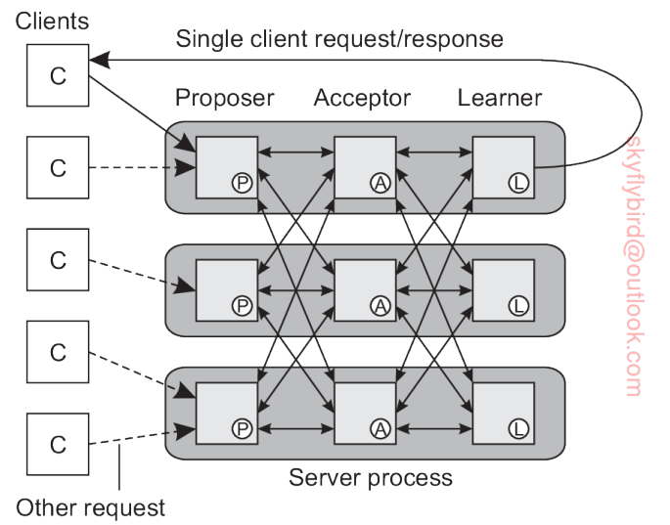
Paxos Components

Slide 6
Paxos的主要符号
Round: 按轮次执行，每一轮包含3个阶段（Phase）。
轮编号rnd：单调增; 后写胜出; 全局唯一。
last_rnd：一个Acceptor看到的最大rnd。
//Acceptor记住这个值来识别哪个proposer可以写。
v：一个Acceptor接受的值。
vrnd：Acceptor接受v的时候的rnd
一个值v被确定（达成共识）：被大多数的Acceptor接受。

Slide 7
Paxos阶段1a
Proposer:
增加自己的rnd，发送prepare消息，带上自己的rnd；
Acceptor：收到prepare请求，
如果请求中rnd比Acceptor的last_rnd小，则拒绝请求；
否则，将请求中的rnd保存到本地的last_rnd；
从此这个Acceptor只接受带有这个last_rnd的phase2请求；
返回promise消息，带上自己之前的last_rnd和之前已接受的v。

Slide 8
Paxos阶段1b
当Proposer收到Acceptor的应答:
如果应答中的last_rnd大于发出的rnd: 退出。
从所有应答中选择vrnd最大的v：不能改变（可能）已确定的值。
如果所有应答的v都是空，可以选择自己要写入v。
如果应答不够多数派，退出。

Slide 9
Paxos阶段2a
Proposer：
发送Accept消息，带上 rnd 和上一步选择的 v。
Acceptor：
拒绝 rnd 不等于自己的 last_rnd的请求（已经promise更大rnd）；
将 Accept中的 v 写入本地，记此 v 为“已接受的值”；
last_rnd==rnd 确保没有其他 Proposer 在此过程中写入过其他值。

Slide 10
Paxos阶段2b
每个Acceptor 发送 Learn消息到所有 Learner；
当一个Learner收到大多数Accpetor的Learn消息，知道一个值被确定了。
多数场合下 Proposer 就是一个 Learner。

Slide 11
例子1：无冲突

Slide 12
例子2：解决并发写冲突

Slide 13
例子3：X 不会修改确定的 V
X 只能选择 v=“y”，
因为它可能是一个被确定的值

Slide 14
Paxos概括
Proposers
Acceptors
Choose unique proposal #
Proposal #
proposal # > any previous?
highest # accepted,
corresponding value
Majority? Select value for highest proposal # returned;
if none, choose own value
#, value selected
proposal # >= any previous?
value accepted
Majority? Value decided

Slide 15
Paxos正确性 – Safety
Property:
If a value v is chosen at proposal number n, any value sent out in phase2 of any later proposal numbers must be also v.
Decision = Majority (any two majorities share at lease one element)
Therefore after the round in which there is a decision, any subsequent round involves at least one acceptor that has accepted v.

Slide 16
Paxos正确性 – Safety
Now suppose our claim is not true, and
let m is the first proposal number that is later than n and
in Phase2, the value sent out is w ≠ v
This is not possible, because
if the proposal P was able to start Phase2 for w,
it means: a majority to accept round for m (for m > n).
So, either:
v would not have been the value decided, or
v would have been proposed by P (i.e., w==v).
Therefore, once a majority accepts v, that never changes.

Slide 17
Paxos正确性 – Liveness
If two or more proposers race to propose new values, they might step on each other toes all the time.
P₁ : prepare(n₁)
P₂ : prepare(n₂)
P₁ : accept(n₁, v₁)
P₂ : accept(n₂, v₂)
P₁ : prepare(n₃)
P₂ : prepare(n₄)
…
n₁ < n₂ < n₃ < n₄
Livelock：
多个 Proposer 并发对 1 个值运行 Paxos 的时候，可能会互相覆盖对方的 rnd，然后提升自己的 rnd 再次尝试，然后再次产生冲突，一直无法完成。
With randomness, this occurs exceedingly rarely.

Slide 18
Paxos – leader based version
A single proposer can be elected as the leader:
receives requests from clients ( or forwarded by other proposers).
increments and associates a unique round number with every request.
sends its proposal to all acceptors, telling each to accept the requested operation.
Benefit:
Largely reduce concurrent proposal and livelock.
Problem:
Additional election mechanism;
Due to asynchrony, multiple leaders may co-exist, still need to handle concurrent proposals.

Slide 19
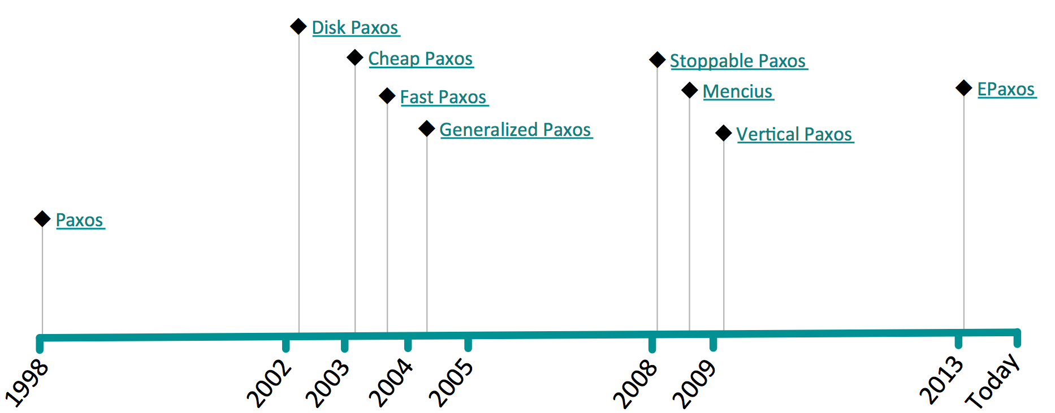
Paxos变种
http://paxos.systems/variants.html

Slide 20
Paxos Problems
Impenetrable: hard to develop intuitions
Why does it work?
What is the purpose of each phase?
Incomplete
Only agrees on single value
Doesn’t address liveness
Choosing proposal values?
Clustering membership management?
Inefficient
Two rounds of messages to choose one value
No agreement on the details
Not a good foundation for practical implementations
“The dirty little secret of the NSDI community is that at most five people really, truly understand every part of Paxos :-)”
-- NSDI reviewer
“There are significant gaps between the description of the Paxos algorithm and the needs of a real world system … the final system will be based on an unproven protocol”
-- Chubby authors

Slide 21
RAFT (Replicated And Fault Tolerant)
https://raft.github.io/

Slide 22
RAFT
Paxos is:
Hard to understand
Not complete enough for real implementations
New consensus algorithm: Raft
Primary design goal: understandability (ease of explanation)
Complete foundation for implementation
Different problem decomposition
Results:
User study show Raft more understandable than Paxos
Widespread adoption

Slide 23
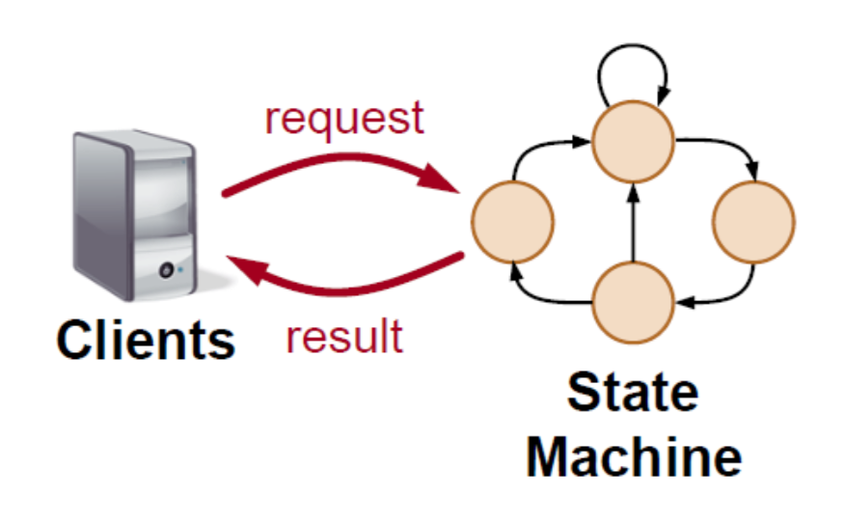
State Machine
Responds to external stimuli
Manages internal state
Examples: many storage systems, services
Memcached
RAMCloud
HDFS name node
…

Slide 24
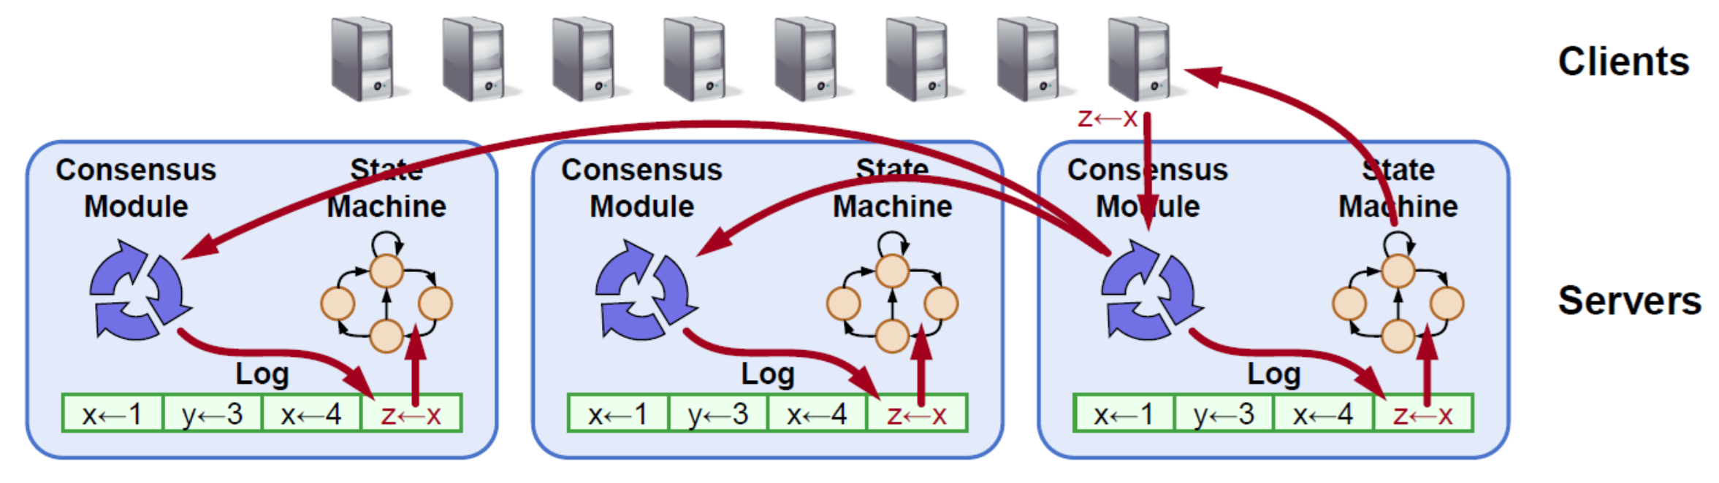
Replicated State Machine
Replicated log ensures state machines execute same commands in same order
Consensus module ensures proper log replication
System makes progress as long as any majority of servers are up
Failure model: delayed/lost messages, fail-stop (not Byzantine)

Slide 25
Raft Methodology
Leader election
Select one server to act as leader
Detect crashes, choose new leader
Log replication (normal operation)
Leader accepts commands from clients, appends to its log
Leader replicates its log to other servers (overwrites inconsistencies)
Safety
Keep logs consistent
Only servers with up-to-date logs can become leader

Slide 26
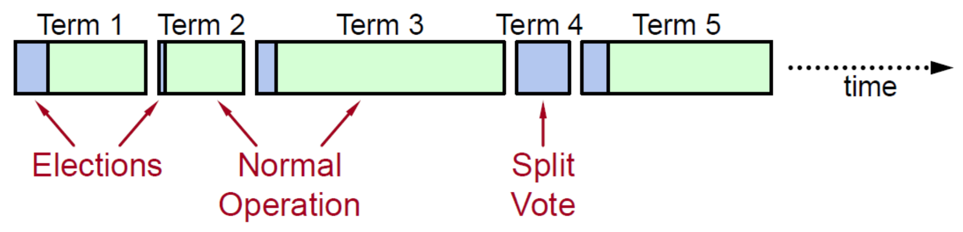
Terms
At most 1 leader per term
Some terms have no leader (failed election)
Each server maintains current term value (no global view)
Exchanged in every RPC
Peer has later term? Update term, revert to follower
Incoming RPC has obsolete term? Reply with error
Terms identify obsolete information

Slide 27
Server States and RPCs
Start
Follower
Passive (but expects
regular heartbeats)
No heartbeat
Discover
higher term
Candidate
Issues RequesVote RPCs
to get elected as leader
Election
Win election
Issues AppendEntries RPCs:
Replicate its log
Heartbeats to maintain leadership
Leader

Slide 28
Leader Election
Become candidate
currentTerm++,
vote for self
timeout
Send RequesVote RPCs
to other servers
votes from majority
RPC from leader
Become leader,
send heartbeats
Become
follower

Slide 29
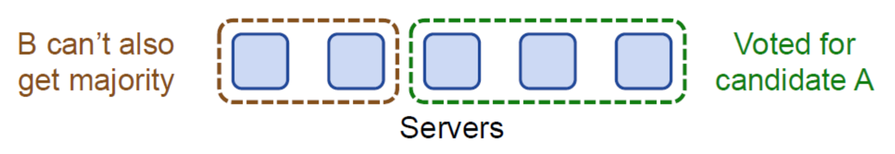
Election Correctness
Safety: allow at most one winner per term
Each server gives only one vote per term ( persist on disk )
Majority required to win election
Liveness: some candidate must eventually win
Choose election timeouts randomly in [T, 2T] (e.g. 150-300 ms)
One server usually times out and wins election before others timeout
Works well if T ≫ broadcast time
Randomized approach simpler than ranking

Slide 30
Normal Operation – Log Replicating
Client sends command to leader
Leader appends command to it log
Leader sends AppendEntries RPCs to all followers
Once new entry committed: (replicated on a majority of servers)
Leader executes command, returns result to client
Leader includes the highest committed index in all later AppendEntries
Followers execute committed commands
Crashed/slow followers?
Leader retries AppendENtries RPCs until they succeed
Optimal performance in common case:
One successful RPC to any majority of servers

Slide 31
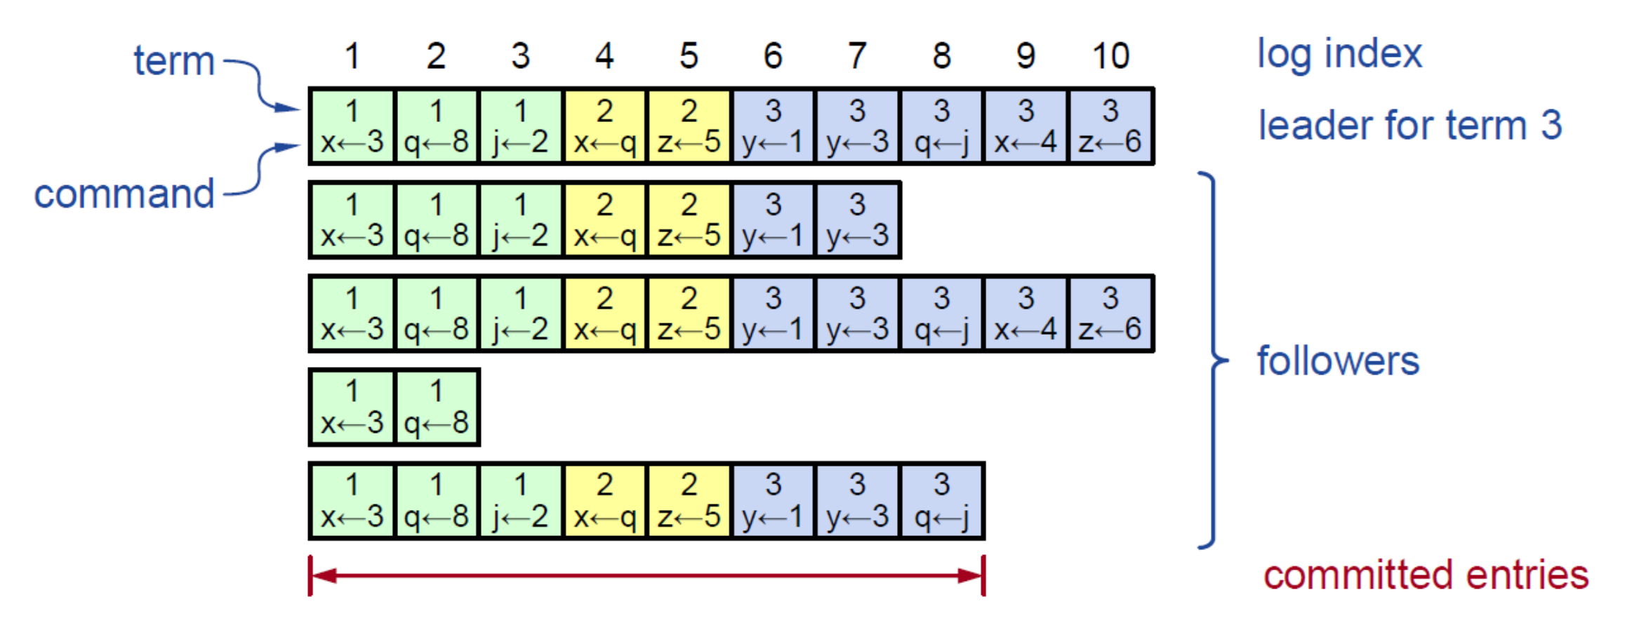
Log Structure
Must survive crashes (store on disk)
Entry committed if safe to execute in state machines
Replicated on majority of servers by leader of its term

Slide 32
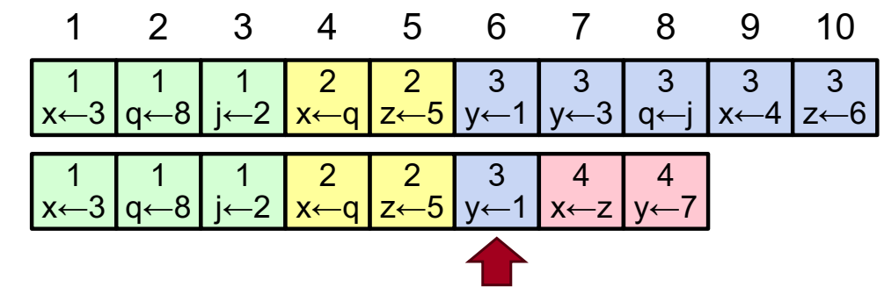
Log Matching Property
Goal: high level of consistency between logs
If log entries on different servers have same index and term:
They store the same command
The logs are identical in all preceding entries
If a given entry is committed, all preceding entries are also
committed

Slide 33
Log Matching Property
Ensuring property S1 (same <index,term> → same command)
Leader creates at most one entry at a given index in a term
This is sent to all the followers
Property S2: (same <index,term> → All previous match)
In <AppendEntries>, leader sends <index,term> of the previous entry in its log.
If the follower finds the previous entry doesn’t matching, it refuses to accept the message
Ensures the Log Matching property by induction

Slide 34
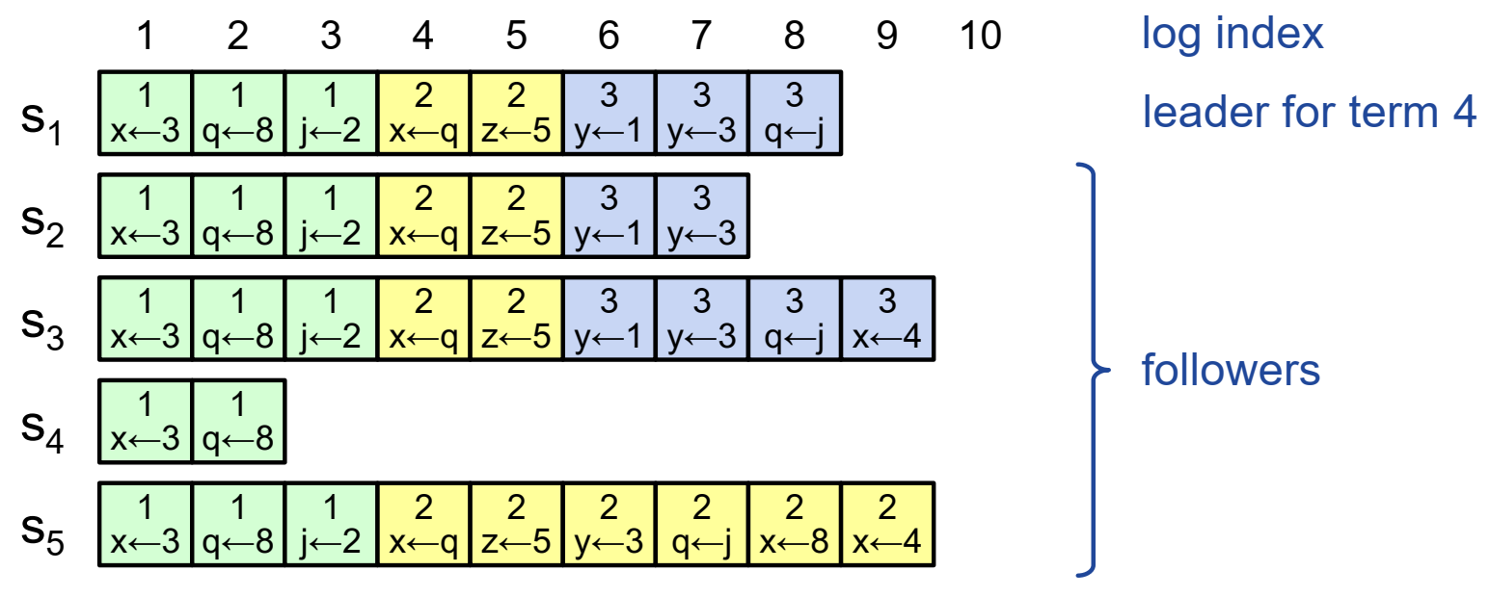
Log Inconsistencies
Crashes can result in log inconsistencies:
Raft forces followers to replicate the leader’s logs
(Leader assumes its log is correct,
never overwrites or deletes entries in its own log.)

Slide 35
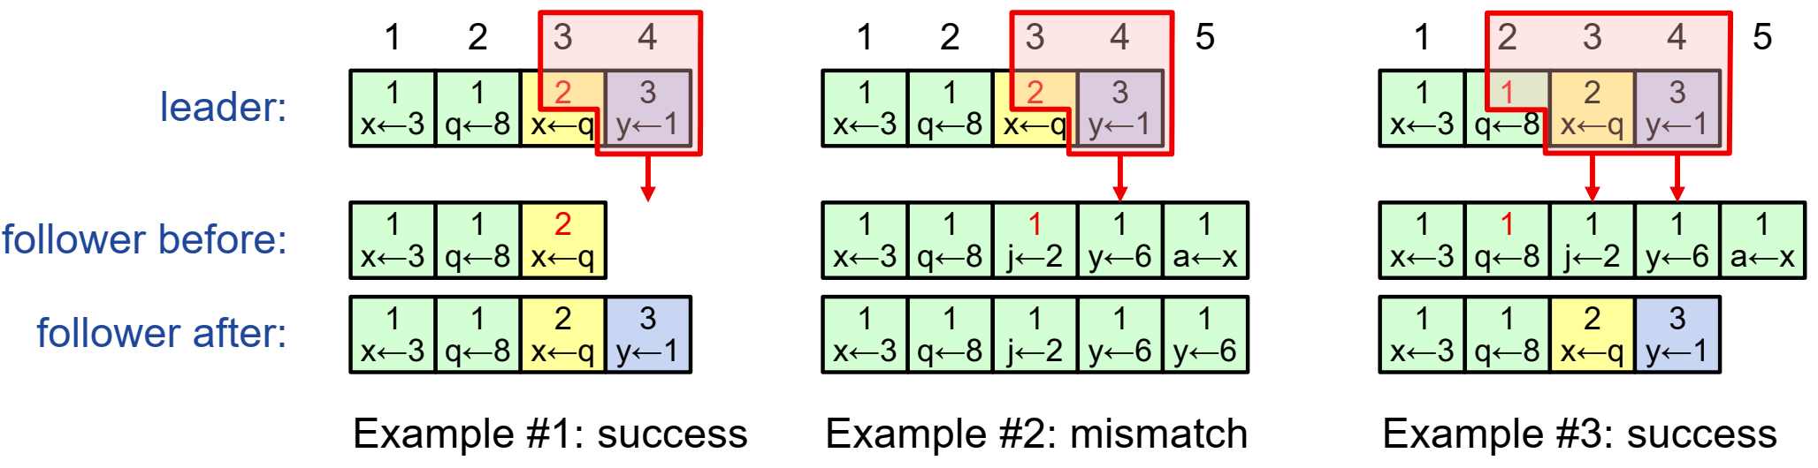
AppendEntries Consistency Check
AppendEntries include <index, term>of entry preceding new one
Follower must contain matching entry;
Otherwise it rejects request:
Leader retries with lower log index;
Ultimately the logs match.
Follower appends all remaining entries from leader’s log.
Implements an induction step, ensures Log Matching Property

Slide 36
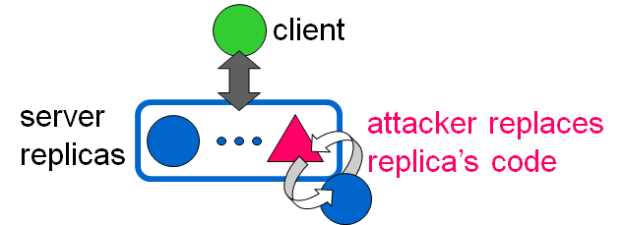
PBFT
Practical Byzantine Fault Tolerant Protocol
Miguel Castro, Barbara Liskov: Practical Byzantine Fault Tolerance. OSDI 1999.
*Partially based on slides by Georgios Piliouras @ Cornell

Slide 37
PBFT vs. Previous
Previous Work is not really practical:
Strong assumption: (synchrony system)
- Bounds on message delay and processing
speed
Poor performance: too many messages.

Slide 38
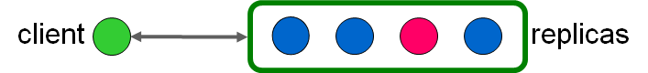
PBFT
The System Model
Asynchronous system
- No bounds on msg delay, or processing speed
(Eventual time bounds for liveness)
Byzantine nodes
- Arbitrary behaviors: delay msg, inconsistent info, et al.
- n : number of processes, f : number of faults
- n > 3 * f + 1
Networks are unreliable
- Can delay, reorder, drop, retransmit
Nodes can verify the authenticity of messages
- Adversary can’t break cryptographic protocols

Slide 39
PBFT
Views
Operations occur within views (i.e., rounds)
For a given view:
- one node in is designated the primary,
- e.g., primary = v mod n
(n is number of nodes, v is the view number)

Slide 40
PBFT
State Machine Replication
Node maintains a state
- Log、view number、state
Can perform a set of operations
- Need not be simple read/write
- Must be deterministic
Well behaved nodes must
- Start at the same state
- Execute requests in the same order
- Correct replicas produce identical replies

Slide 41
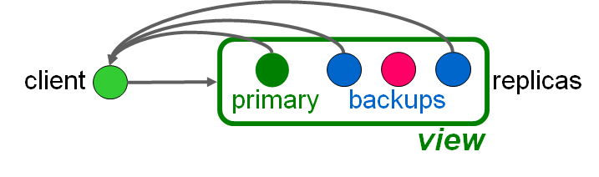
PBFT
Ordering Requests
Primary picks ordering
Backups ensure primary behaves correctly
certify correct ordering
trigger view changes to replace faulty primary

Slide 42
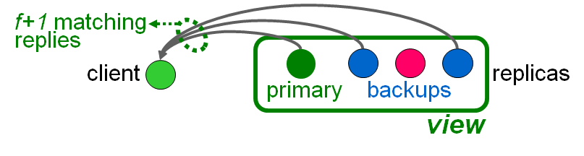
PBFT
Overall Procedure
1. A client sends a request to the primary;
2. The primary multicasts the request to backups;
3. Each replica executes the request and send a reply to the client;
4. The client waits for f+1 replies from different replicas with the same result; this is the result of the operation.

Slide 43
PBFT
Overall Procedure
If the client does not receive replies soon enough
it broadcasts the request to all replicas.
If the request already processed, simply resend the reply.
If the replica is not the primary,
- it relays the request to the primary.
If the primary does not multicast the request to others
- it will eventually be suspected to be faulty by enough
replicas to cause a view change

Slide 44
PBFT
Protocol Components
Normal case operation
View change
Garbage collection
Recovery
All have to be designed to work together

Slide 45
PBFT
Normal Case Operation
Three phase algorithm:
pre-prepare picks order of requests
prepare ensures order within views
commit ensures order across views
Replicas remember messages in log
Messages are authenticated

Slide 46
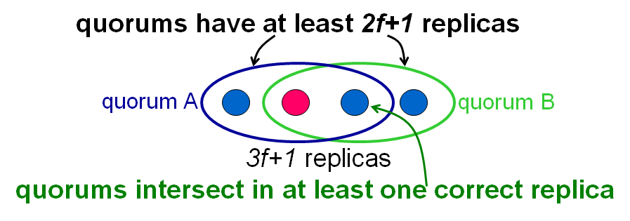
PBFT
Protocol Operations
Certificates: set with messages from a quorum
Algorithm steps are justified by certificates

Slide 47
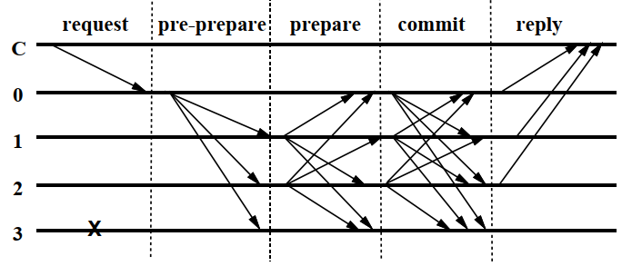
Request
PBFT
Request to Primary
{REQUEST, operation, ts, client}
fail
Primary assigns seq# to the request.

Slide 48
PBFT
Pre-prepare
Pre-prepare message
<{PRE_PRAPARE,v,seq#,msg_digest}, msg>
fail
backups accept pre-prepare if:
in view v
never accepted pre-prepare for v,seq# with different request

Slide 49
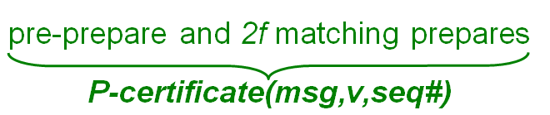
PBFT
Prepare
Prepare message
{PRAPARE,view,seq#,msg_digest,i}
fail

Slide 50
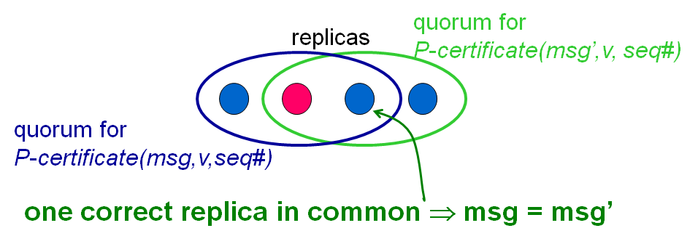
PBFT
Order Within View
No P-certificates with the same view and sequence number and different requests

Slide 51
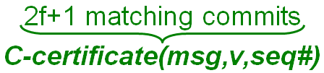
PBFT
Commit
Commit message
{COMMIT,view,seq#,msg_digest,i}
fail

Slide 52
PBFT
Reply
Reply
{REPLY,view,ts,client,i,response}
fail
Request m executed after:
having C-certificate(msg,v,seq#)
executing requests with number less than seq#

Slide 53
PBFT
View Change
Provide liveness when primary fails:
- timeouts trigger view changes
- select new primary
But also need to:
- preserve safety
- ensure replicas in the same view long enough
- prevent denial-of-service attack

Slide 54
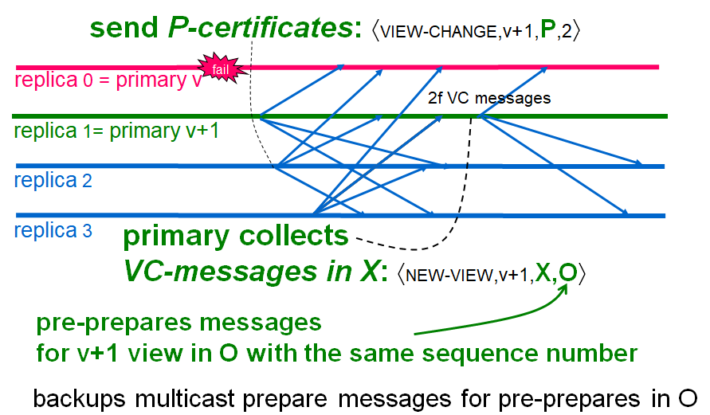
PBFT
View Change

Slide 55
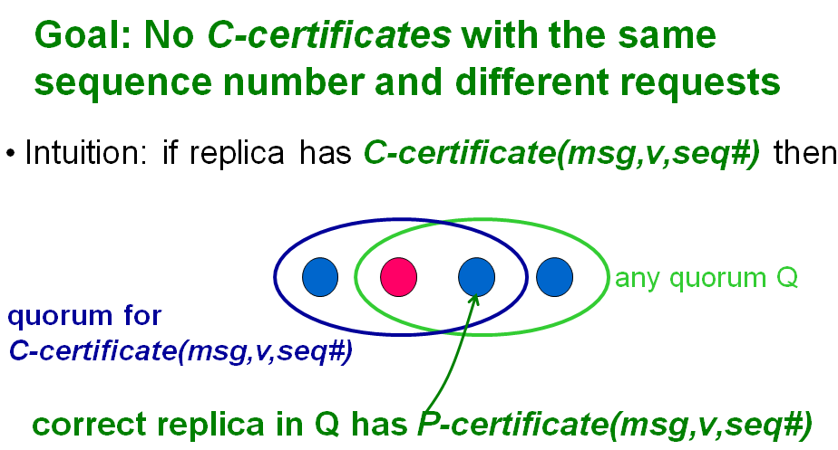
PBFT
View Change Safety

Slide 56
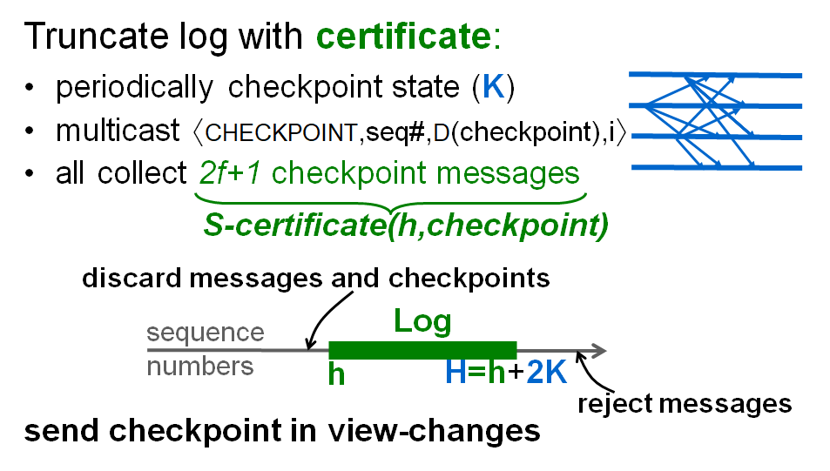
PBFT
Garbage Collection

Slide 57
PBFT
Formal Correctness Proofs
Complete safety proof with I/O automata:
- invariants
- simulation relations
Partial liveness proof with timed I/O automata:
- invariants

Slide 58
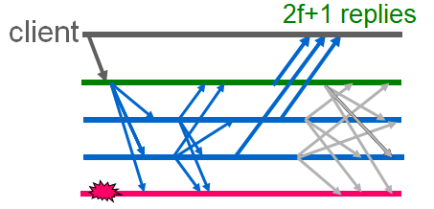
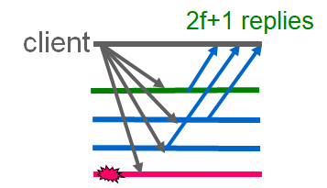
PBFT
PBFT Optimizations
Digest replies: send only one reply with full result
Optimistic execution: execute prepared requests
Read-only operations: executed in current state

Slide 59
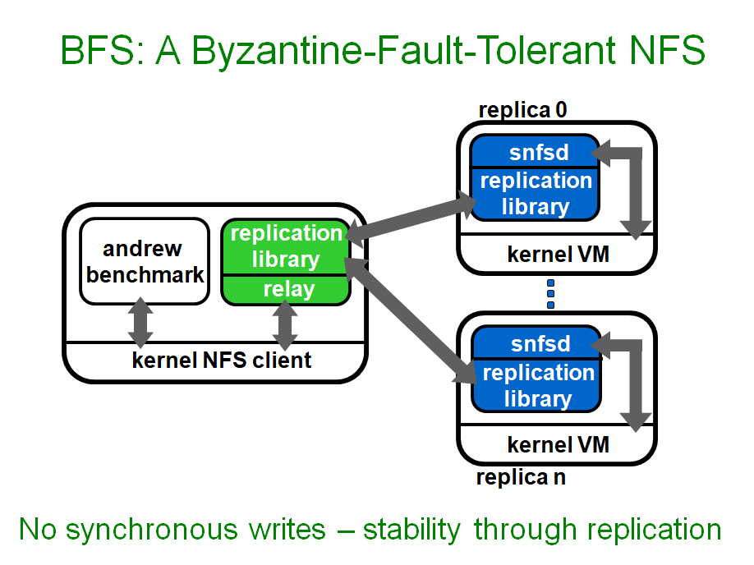
PBFT
Implementation Example

Slide 60
谢谢！

